Slide 1
AGENDA Day One
3/7/2020
Cloud Deployment Types
Cloud Service Models
1.
2.
3.
What is Cloud Computing
Public Cloud
Private Cloud
Hybrid Cloud
Saas
Paas
Iaas
Task
4.
Introduction to Amazon Web Services
5.
Aws Account Creation

Slide 2
Important Terms
01.
Data Center
02.
Scale Out
03.
Horizontal vs Vertical Scaling
04.
Virtualization
05.
Tenancy
06.
Json and Yaml
07.
API – Application Programing Interface
08.
Micro Services

Slide 3
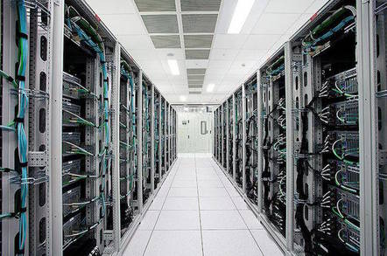


A data centre is a building, dedicated space within a building, used to house computer systems and associated components, such as telecommunications and storage systems and servers.
IT operations are crucial for business continuity, it generally includes redundant or backup components and infrastructure for power supply data communication connections, environmental controls (e.g. air conditioning, fire suppression) and various security devices.
A data centre can be owned by an organization or a Third party Service Provider or a user

Slide 4






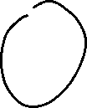

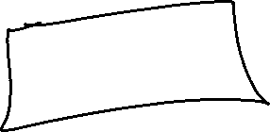












Slide 5




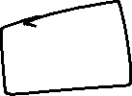





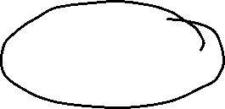











Slide 6









































Slide 7










Slide 8
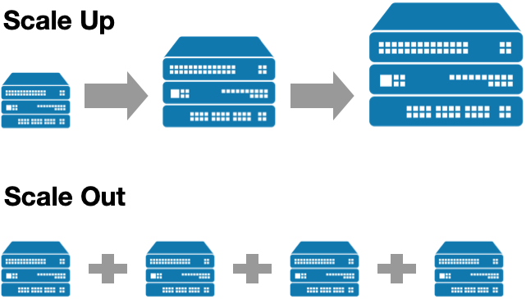

Slide 9
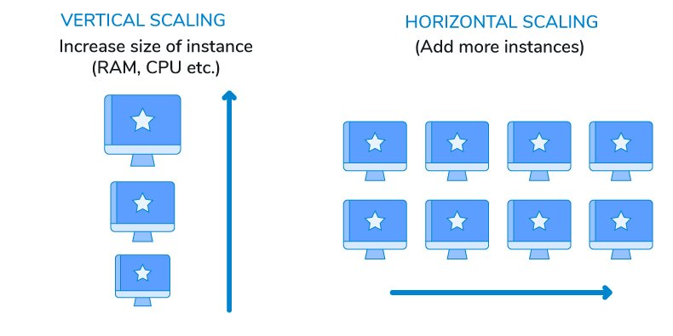





Slide 10
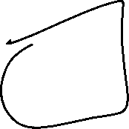
































Slide 11
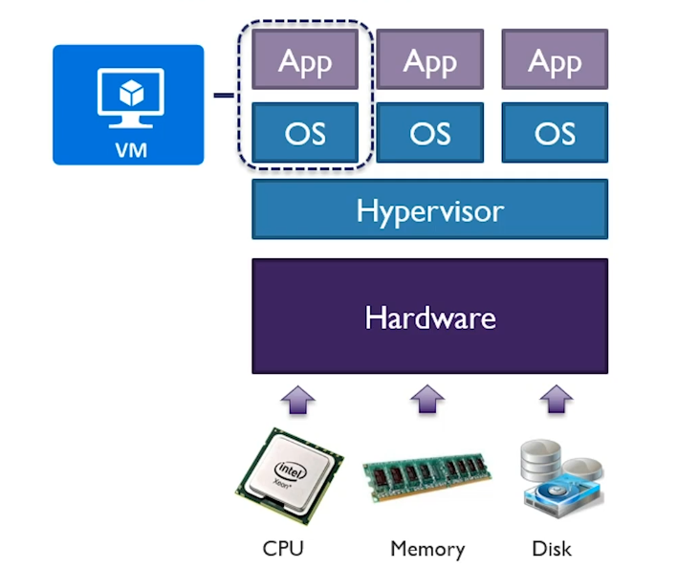

A Virtual Machine (VM) is a Operating system that not only exhibits the behaviour of a separate computer, but is also capable of performing tasks such as running applications and programs like a separate computer

Slide 12
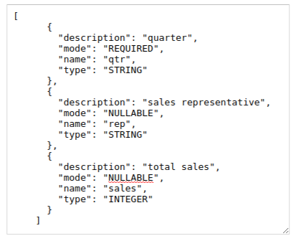
Json JavaScript Object Notation

Slide 13
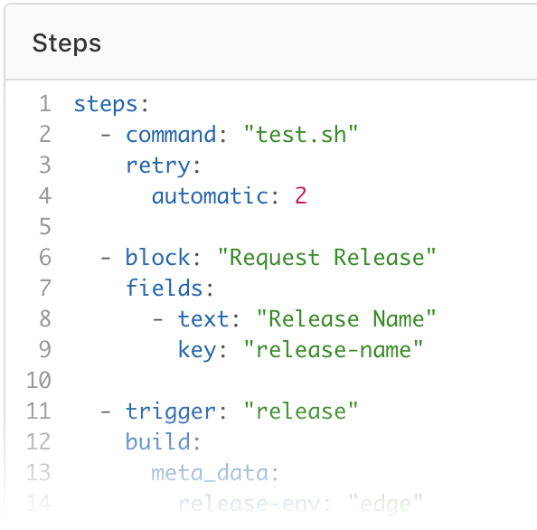
Yaml YAML Ain't Markup Language

Slide 14
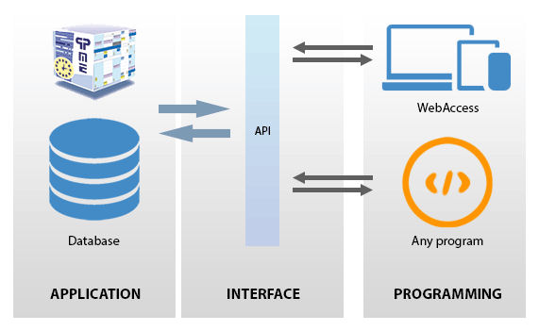
Api Application Programming Interface

Slide 15
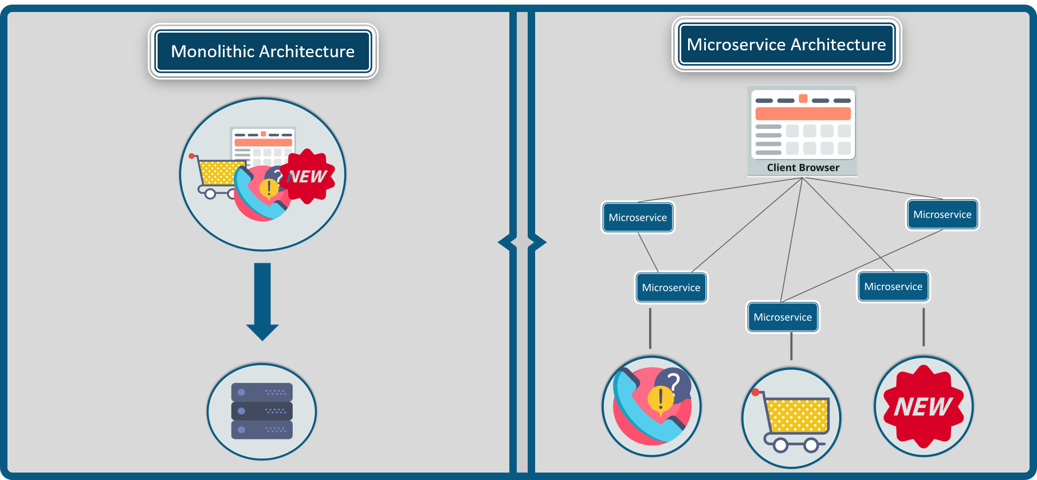
Micro Services v/s Monolithic Services

Slide 16
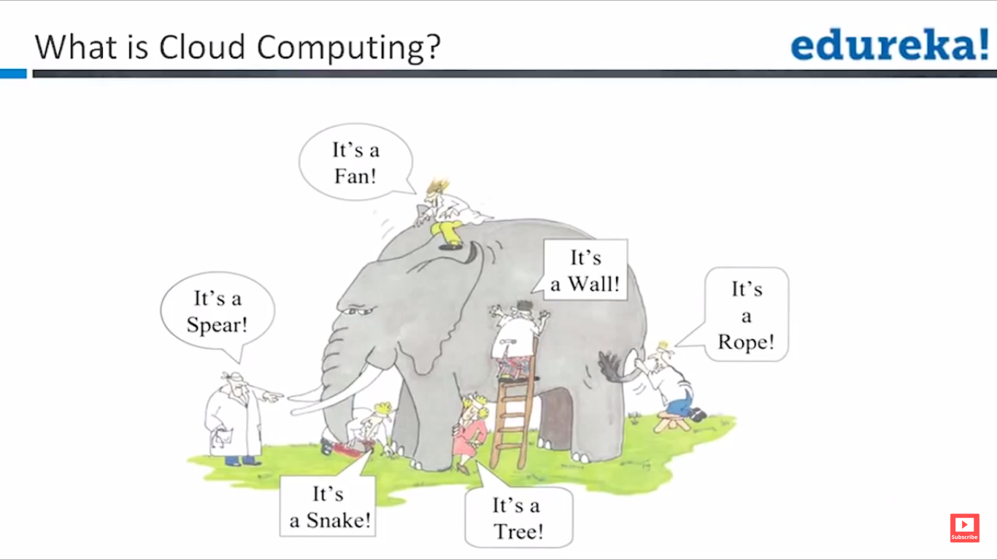

Slide 17
What is cloud computing ?
"cloud computing is a model for convenient, on-demand network access to a shared pool of configurable computing resources (e.g., networks, servers, storage, applications and services) that can be rapidly provisioned and released with minimal management effort or service provider interaction.“
National Institute of Standards and Technology (NIST)

Slide 19
Cloud Attributes
Broad Network Access
Rapid Elasticity
Multi Tenancy
On Demand self-service
Resource Pooling

Slide 20
Cloud Deployment Types
The public cloud is defined as computing services offered by third-party providers over the public Internet, making them available to anyone who wants to use or purchase them
Eg: AWS, Azure , GCP
1
Public Cloud
A private cloud refers to cloud computing resources used exclusively by a single business or organisation. A private cloud can be physically located on the company’s on-site datacenter. Some companies also pay third-party service providers to host their private cloud. A private cloud is one in which the services and infrastructure are maintained on a private network.
2
Private Cloud
Hybrid clouds combine public and private clouds, bound together by technology that allows data and applications to be shared between them. By allowing data and applications to move between private and public clouds, a hybrid cloud gives your business greater flexibility, more deployment options compliance.
3
Hybrid Cloud

Slide 21
